Slide 1

CSE- 321
Software Engineering
Lecture : 02 Introduction (Cont.)
Fahad Ahmed
Lecturer, Dept. of CSE
E-mail: fahadahmed@uap-bd.edu

Slide 2
Lecture Outlines
Classification of Software
What is Software Engineering?
Importance of Software Engineering
Program vs Software Product
Software Engineering vs System Engineering
Software Process
Software Process Model
Key Challenges Facing Software Engineering
Software Engineering Ethics

Slide 3
Software process
What is a software process?
A software process is a sequence of activities that leads to the production of a software product.
Generic activities in all software processes are:
Software Specification
Software Development
Software Validation
Software Evolution

Slide 4
General issues that affect software
General issues that affect software
Heterogeneity
Business and social change
Security and trust
Scale

Slide 5
Software Process Model
What is a software process model?
A software process model is a simplified description of a software process that presents one view of that process. Process models may include activities that are part of the software process, software products and the roles of people involved in software engineering.
Examples of process perspectives are:
Workflow perspective - sequence of activities, UML Sequence Diagrams
Data-flow perspective - information flow, DFD’s
Role/action perspective - who does what. Gantt Charts
Most software process models are based on one of three general models or paradigms of software development:
The waterfall approach
Iterative development
Component-based software engineering (CBSE)

Slide 6
Key challenges facing software engineering
What are the key challenges facing software engineering?
Coping with legacy systems, coping with increasing diversity and coping with demands for reduced delivery times.
Legacy systems – old, valuable systems must be maintained and updated.
Heterogeneity – systems are distributed and include a mix of hardware and software.
Delivery – there is increasing pressure for faster delivery of software.

Slide 7
Internet Software Engineering
The Web is now a platform for running application and organizations are increasingly developing web-based systems rather than local systems.
Web services allow application functionality to be accessed over the web.
Cloud computing is an approach to the provision of computer services where applications run remotely on the ‘cloud’.
Users do not buy software buy pay according to use.

Slide 8
Engineering ethics
Ethics (dictionary) “the philosophy of morals or the standard of character set by any nation or race”
Morals (dictionary) “pertaining to action with reference to right and wrong”
Engineering ethics:
“Study of Moral Values, Issues and Decisions as they relate to Engineering Practice”
THE KILLER ROBOT, DC – 10 JUMBO JET
What about that??

Slide 9
Software engineering ethics
Engineers are expected to exhibit the highest standards of honesty and integrity. Engineering has a direct and vital impact on the quality of life for all people.
Accordingly, the services provided by engineers require honesty, impartiality, fairness, and equity, and must be dedicated to the protection of the public health, safety, and welfare.
Engineers must perform under a standard of professional behaviour that requires adherence to the highest principles of ethical conduct.
Engineering ethics can be considered in three frames of reference—individual, professional, and social.

Slide 10
Issues of professional responsibility
Software engineering ethics
Confidentiality
Engineers should normally respect the confidentiality of their employers or clients irrespective of whether or not a formal confidentiality agreement has been signed.
Competence
Engineers should not misrepresent their level of competence. They should not knowingly accept work which is out with their competence.

Slide 11
Issues of professional responsibility
Software engineering ethics
Intellectual property rights
Engineers should be aware of local laws governing the use of intellectual property such as patents, copyright, etc. They should be careful to ensure that the intellectual property of employers and clients is protected.
Computer misuse
Software engineers should not use their technical skills to misuse other people’s computers. Computer misuse ranges from relatively trivial (game playing on an employer’s machine, say) to extremely serious (dissemination of viruses).

Slide 12
Q: Intellectual property rights
The reuse of software raises a number of copyright and intellectual property issues. If a customer pays a software contractor to develop a system.
Who has the right to re-use the developed code?
Does the software contractor have the right to use that code as a basis for a generic component?
Discuss these issues and other ethical issues associated with the reuse of software.
Answer:
https://paigepecksite.wordpress.com/2016/09/29/hw15-chapter-15/

Slide 13
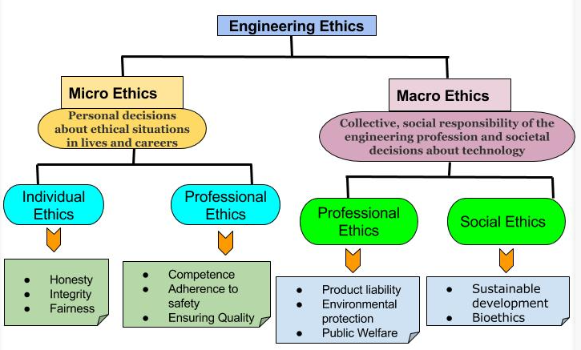
Software engineering ethics
https://iesgeneralstudies.com/ethics-in-engineering-profession/

Slide 14

Thanks to All

